Slide 1
Comprehensive VHDL Hamdi Abdelbagi Phone: (937) 830-7761 Email: abdelbagih1@udayton.edu

Slide 2
FSM Synthesis
Aim
To understand how to write and synthesize finite state machines using VHDL
Topics covered
Moore and Mealy machine
State transition diagram
Enumeration types
Single process style
State encoding
Unreachable state and input hazards

Slide 3
Finite State Machine

Slide 4
FSM Implementation

Slide 5
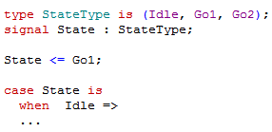
Enumeration Types
Define a new data type for a state machine
Identifiers appear in the waveform viewer – good for debugging

Slide 6
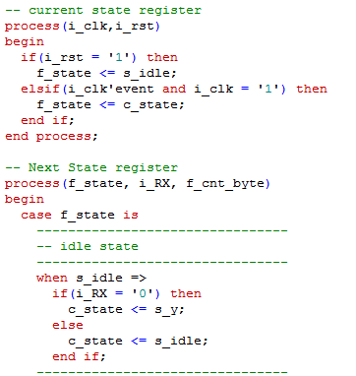
State Machine in VHDL

Slide 7
State Machine in VHDL

Slide 8
Timing in a synchronous design
The FSM is assumed to be part of a synchronous block
Synthesize with reset of block or apply appropriate timing constrains

Slide 9
One Process State Machine Description

Slide 10
State Encoding

Slide 11
Unreachable States

Slide 12
Asynchronous Inputs
You must NOT apply asynchronous inputs to a state machine
State flip-flop could see inputs change at different instants

Slide 13
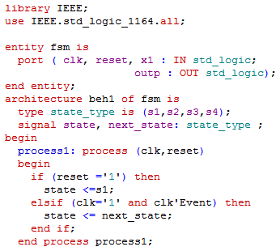
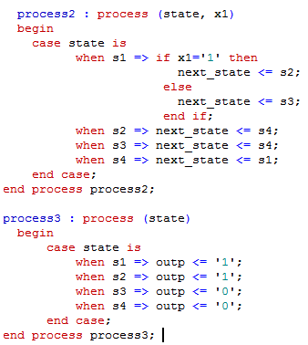
FSM with three processes

